Slide 1
CSE1201: Object Oriented Programming-I (C++)
Lecture 2

Slide 2
Introduction to C++
Programming Concept
Basic C++
C++ Extension from C

Slide 3
Focus
Focus on
Programming Concepts
Programming Design Techniques
Don’t get lost in
Language Technical Details

Slide 4
What is a Language?
A Language is
a structured system of communication
Structure
Semantics
Sounds and symbols
Grammar

Slide 5
What is a Programming Language?
A Programming Language
is
a vocabulary
and
set of grammatical rules
for
instructing a computer or computing device
to
perform specific tasks

Slide 6
What is programming?
Programming is taking
A problem
Find the area of a rectangle
A set of data
length
width
A set of functions
area = length * width
Then,
Applying functions to data to solve the problem

Slide 7
Programming Concept Evolution
Programming paradigm:
Fundamental style of computer programming
Types
Non structured programming
Structured/Procedural programming
Object oriented programming
Others

Slide 8
Non Structured Programming Paradigm
Code is written in single continuous program
Lines may be numbered or labeled
Allows control flow to jump to any line
hardly-readable
Example:
early versions of BASIC
Sample BASIC Program
10 CLS
20 PRINT "Helloooooooooooooo, world!"
30 PRINT "I'm making the sample program clear and understandable."
40 PRINT "This text is being printed via the PRINT command."
50 PRINT "On the next line, I'll use CLS, which will clear everything I just printed, so you won't even see the preceding text."
55 PRINT "Also, you can't give CLS a line to PRINT; it won't actually do anything"
60 CLS "These words actually do nothing; they do not PRINT or anything."
70 PRINT "Finally, on line 80, I'll use END, which will keep me from reaching line 90."
80 END "Like CLS, putting a string here does nothing; it does not PRINT or anything."
90 PRINT "this is not really my answer."

Slide 9
Non Structured Programming Paradigm - Limitation
Difficult to maintain code as size of the program increases.
Code can not be reused.
Difficult to test
Lack of clarity.
Difficulty in maintenance.

Slide 10
Structured/Procedural Programming Paradigm
Program is divided into smaller subtasks/modules
Helps in modularity
Complexity made manageable
Maintenance made easier
Control flow between modules can be defined in a structured manner
Each module has inputs and a defined output
Examples
C, PASCAL

Slide 11
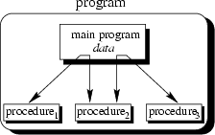
Procedural Concept
The main program coordinates calls to procedures and hands over appropriate data as parameters.

Slide 12
Procedural Concept (II)
Procedural Languages
C, Pascal, Basic, Fortran
Facilities to
Pass arguments to functions
Return values from functions
For the rectangle problem, we develop a function
int compute_area (int l, int w){
return ( l * w );
}

Slide 13
Object Oriented Programming
Any programming problem is analyzed in terms of objects
Objects contain data, and code to manipulate that data
Useful for development of enterprise applications
Has features for data security, code reuse and maintainability
Examples
C++, Java

Slide 14
Object –Oriented Programming
Programs are divided into objects.
Objects can communicate with each other through functions
New data and functions can be easily added whenever necessary

Slide 15
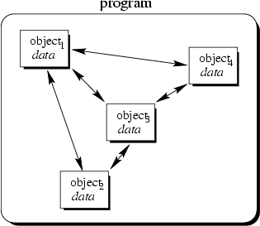
Object-Oriented Concept
Objects of the program interact by sending messages to each other

Slide 16
Objects and Classes
A class is a user defined data type and an object is a variable of that data type
Class define the data and code that should be included in each object of that class
A class is a template for an object and an object is an instance of a class

Slide 17
Objects
An object is an encapsulation of both functions and data
Objects are an Abstraction
represent real world entities
Classes are data types that define shared common properties or attributes
Objects are instances of a class
Objects have State
have a value at a particular time
Objects have Operations
associated set of operations called methods that describe how to carry out operations
Objects have Messages
request an object to carry out one of its operations by sending it a message
messages are the means by which we exchange data between objects

Slide 18
OO Perspective
Let's look at the Rectangle through object oriented eyes:
Define a new type Rectangle (a class)
Data
width, length
Function
area()
Create an instance of the class (an object)
Request the object for its area
In C++, rather than writing a procedure, we define a class that encapsulates the knowledge necessary to answer the question - here, what is the area of the rectangle.

Slide 19
Example Object Oriented Code
class Rectangle
{
private:
int width, length;
public:
Rectangle(int w, int l)
{
width = w;
length = l;
}
int area()
{
return width*length;
}
};
main()
{
Rectangle rect(3, 5);
Rectangle rect2(5, 10);
cout << rect.area()<<endl;
}

Slide 20
Object-Oriented Programming Languages
Characteristics of OOPL:
Encapsulation
Abstraction
Inheritance
Polymorphism
OOPLs support :
Modular Programming
Ease of Development
Maintainability

Slide 21
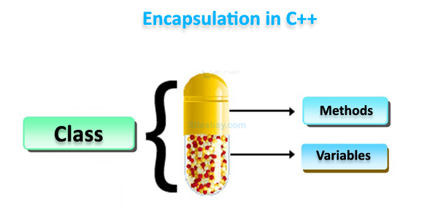
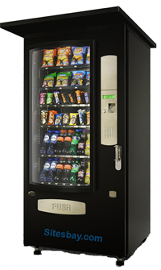
Data Encapsulation
Encapsulation: Combining data structure with actions
Data structure: represents the properties, the state, or characteristics of objects
Actions: permissible behaviors that are controlled through the member functions

Slide 22
Data Encapsulation
Data hiding: Process of making certain data inaccessible
The data is not usually accessible to the outside world, and only those functions which are wrapped in the class can access it
The methods provides interface between the data of the object, and the program
This ensures data hiding

Slide 23
Data Encapsulation
class Rectangle
{
private:
int width, length;
public:
Rectangle(int w, int l)
{
width = w;
length = l;
}
int area()
{
return width*length;
}
};
main()
{
Rectangle rect(3, 5);
cout << rect.area()<<endl;
}

Slide 24
Data Encapsulation
Abstraction:
Showing only the necessary details to the intended user
the object can be used by knowing what is does, and without having to know how it works

Slide 25
Inheritance
Inheritance: Ability to derive new objects from old ones
permits objects of a more specific class to inherit the properties (data) and behaviors (functions) of a more general/base class
ability to define a hierarchical relationship between objects
It provides the idea of reusability

Slide 26
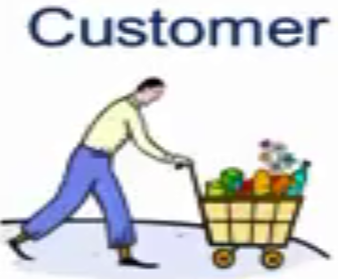

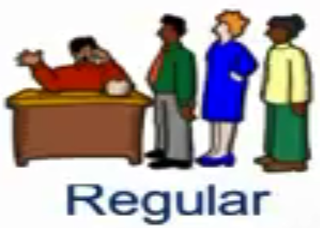

Inheritance
customer
Customer ID
Customer Name
Telephone No.
Address
Customer_ discount
Customer_gift
Customer ID
Customer Name
Telephone No.
Address
Get discount (on purchase)
Get discount (on purchase)
Get Gifts (on Membership)
Customer ID
Customer Name
Telephone No.
Address
Get Gifts (on Membership)

Slide 27
Polymorphism
Polymorphism: Ability for different objects to interpret functions differently
Polymorphism means the ability to take more than one form
Allows one interface, multiple methods
In simple terms, polymorphism allows one interface to control access to a general class of actions
The specific action is determined by the exact nature of the situation

Slide 28
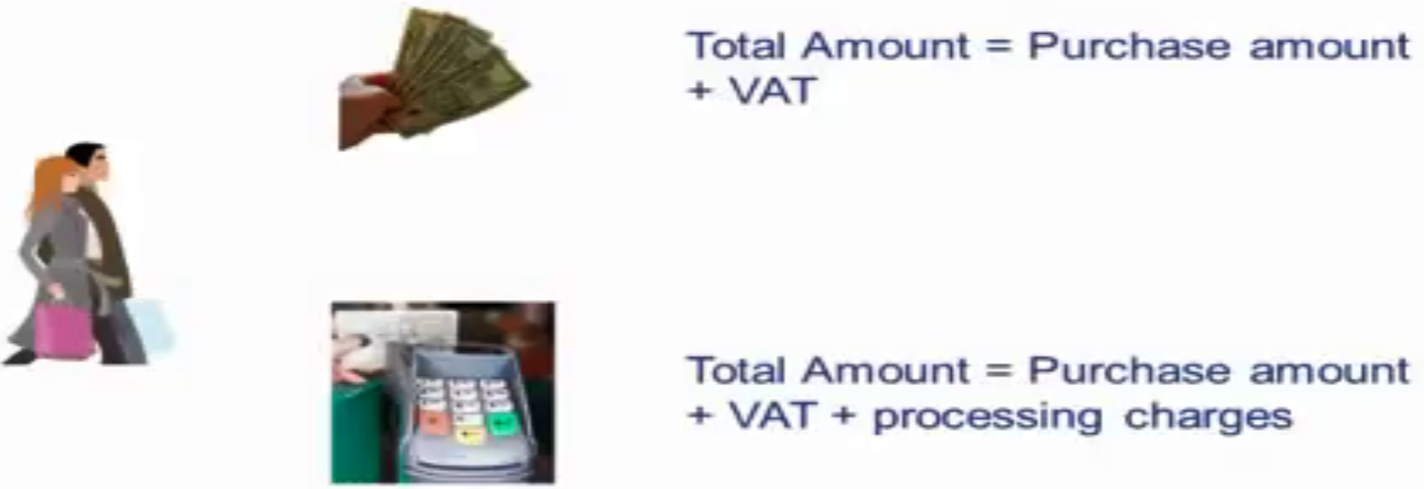
Polymorphism
Both are bill computation, but the internal process differs
Activity of bill payment is same

Slide 29
Polymorphism
int add(int a, int b) → adds two integer number
float add (float a, float b) → adds two float numbers
double add(double a, double b)→ adds two double numbers

Slide 30
Advantages of OOP
Through inheritance, we can eliminate redundant code and extend the use of existing classes
Inheritance leads to saving of time and higher productivity
The principle of data hiding produces more secure program
System can easily be upgraded from small to large system
Software complexity can easily handled

Slide 31
Take Home Message
There are many different kinds of programming paradigms, OOP is one among them.
In OOP, programmers see the execution of the program as a collection of dialoging objects.
The main characteristics of OOPL include encapsulation, inheritance, and polymorphism.

Slide 32
Thank you

